Slide 1

Acids and Bases chapter 21

Slide 2
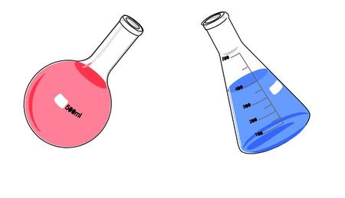
What are acids ? Properties
Sour taste
Strong acids are corrosive
Notes:
Strong acid (car battery) come into contact with skin, breaks down proteins and fats in tissue- acid burn.
Acid burns are serious & slow to heal. Corrosives must be handeled with care

Slide 3
Acids
Everyday acids:
Lab acids:
Citrus fruits
Sulfuric acids (car battery)
Carbonic acid (rainwater)
Hydrochloric acid (HCl)
Sulfuric acid (H₂S0₄)

Slide 4
What are Bases ? Properties
Soapy feel when they react with water
Many bases are as corrosive and as dangerous as acids
Some bases will dissolve in water. They are known as alkali (alkaline).
Notes:
Many bases are as corrosive and as dangerous as acids. For example, caustic soda, which is used to clear drains, is a corrosive base and must be handled with care (and gloves!).

Slide 5
Bases
Everyday bases :
Lab acids:
Bleach
Egg white
Toothpaste
Ammonia
Calcium hydroxide

Slide 6

Neutral
There is another group of substances that are neither acid nor base.
They are said to be neutral.
Notes:
Water

Slide 7
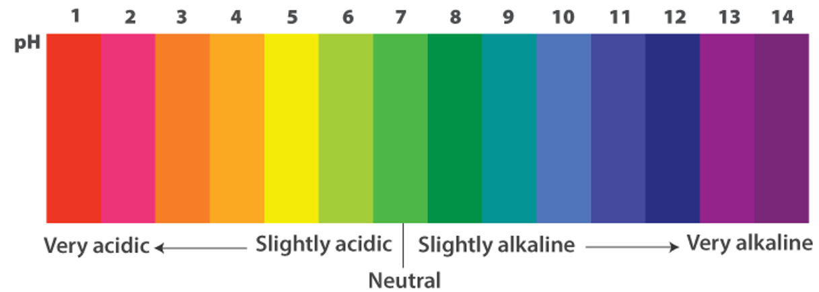
pH Scale
Measure of how acidic or basic something is
A scale from 0-14 that determines how basic, acidic or neutral something is.

Slide 8
How can you tell an acid from a base?
You have to test it with an indicator.
An indicator is a chemical that changes colour depending on the pH.

Slide 9
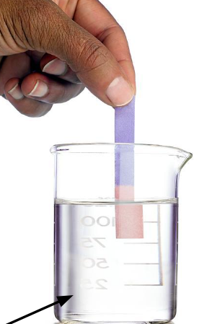
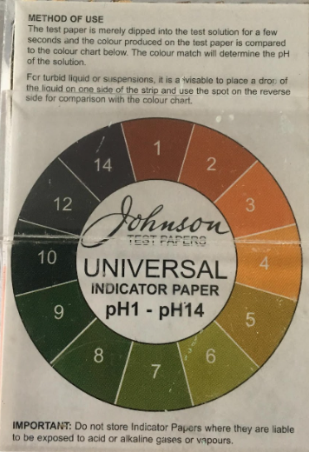
Indicators
An indicator is a chemical that changes colour depending on the pH.
Two types of indicators:
Litmus paper
Universal indicator

Slide 10
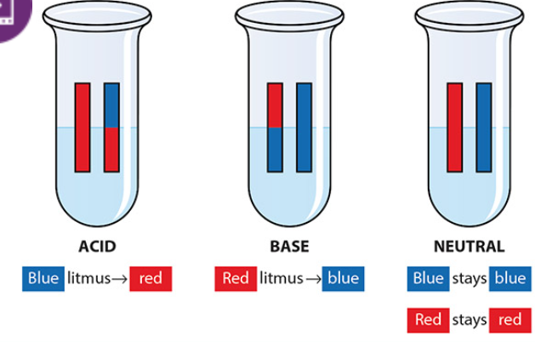
Litmus indicator
Treated with a water-soluble mixture of different dyes.
There is blue litmus paper and red litmus paper.
Notes:
Remember: b for base, b for blue litmus.

Slide 11
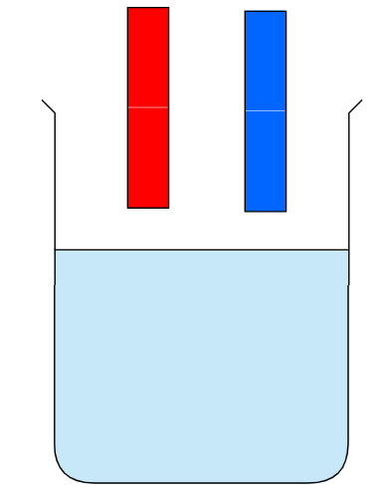
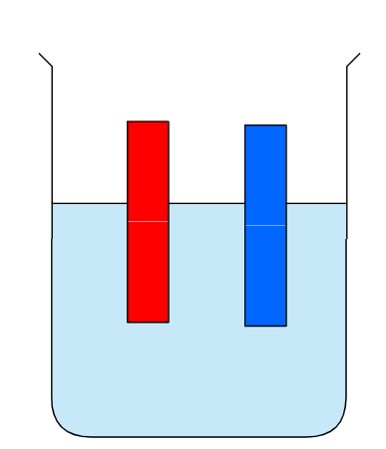
Neutral
There is another group of substances that are neither acid nor base.
They are said to be neutral.
Notes:
Water

Slide 12
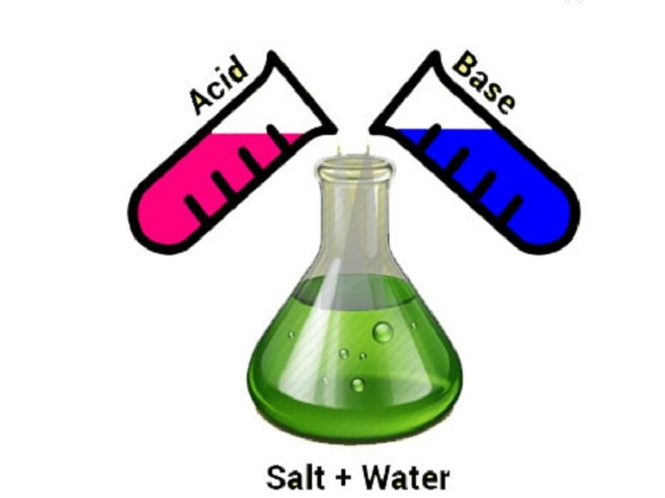
Neutralisation
Acid and a Base react to produce salt and water
With the right amounts, the acid and base will cancel out. Neutralised reaction.
Neutralisation:
Acids + base = salt + water

Slide 13
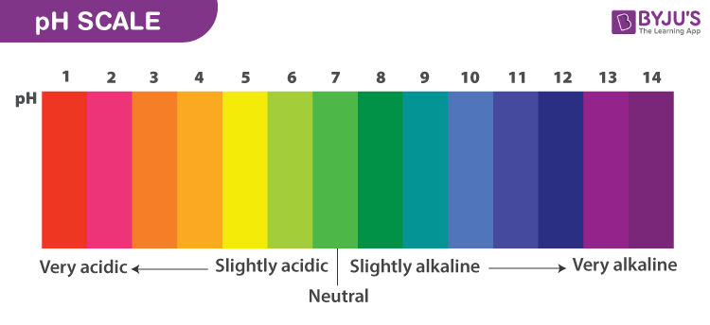
Universal indicator
A mixture of dyes that change colour according to how strong the acid or base is.
Range of colours.

Slide 14
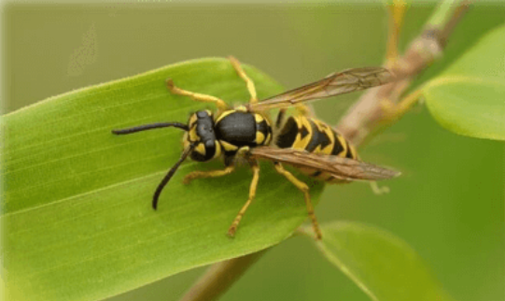
Wasp sting – alkaline base.

Slide 15

The students are discussing what pH indicators show.
A pH indicator shows you how dangerous a chemical is by changing colour.
Acids always turn red and alkalis turn blue or purple.
There are different types of indicators; not all of them show all of the pH scale.
A pH indicator shows how much acid something contains.
?
What’s your idea?

